Slide 2
State-of-charge Segment Production Cost and Bidding Model for Energy Storage
Ningkun Zheng¹, Xin Qin², Di Wu³, Gabe Murtaugh⁴, Bolun Xu¹,
¹Columbia University, New York, NY,
²University of Cambridge, Cambridge, United Kingdom,
³Pacific Northwest National Laboratory, Richland, WA,
⁴California ISO, Folsom, CA.

Slide 3
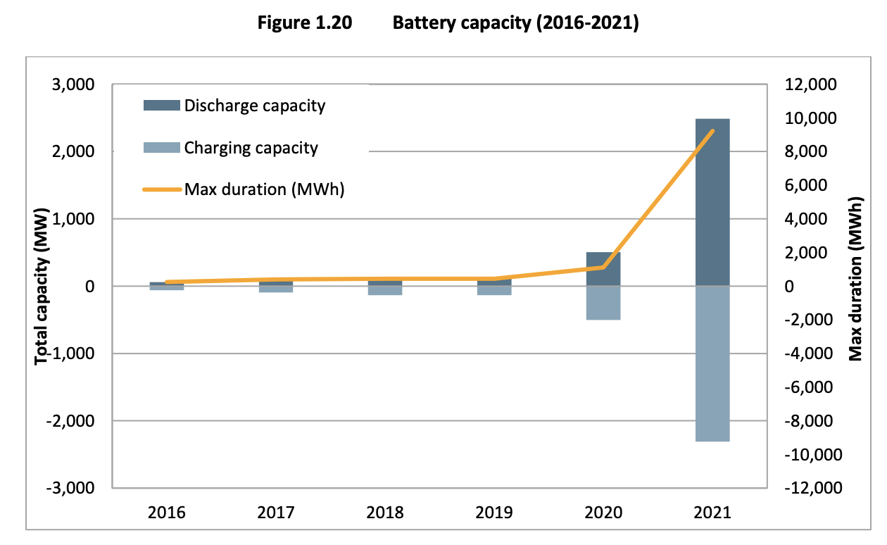
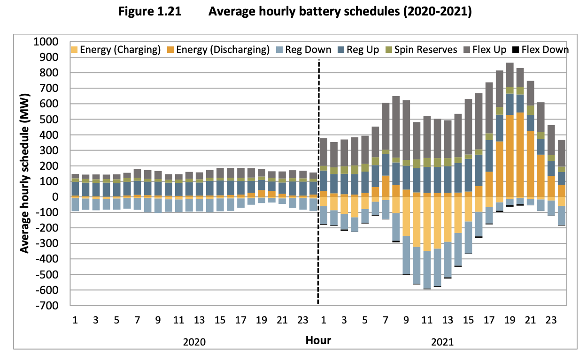
Motivation
The amount of battery capacity increased significantly
Hildebrandt, Eric, et al. "2021 annual report on market issues & performance." California ISO Department of Market Monitoring (2022).
US Energy Information Administration. "Form EIA-860 Annual Electric Generator Report." (2022).

Slide 4
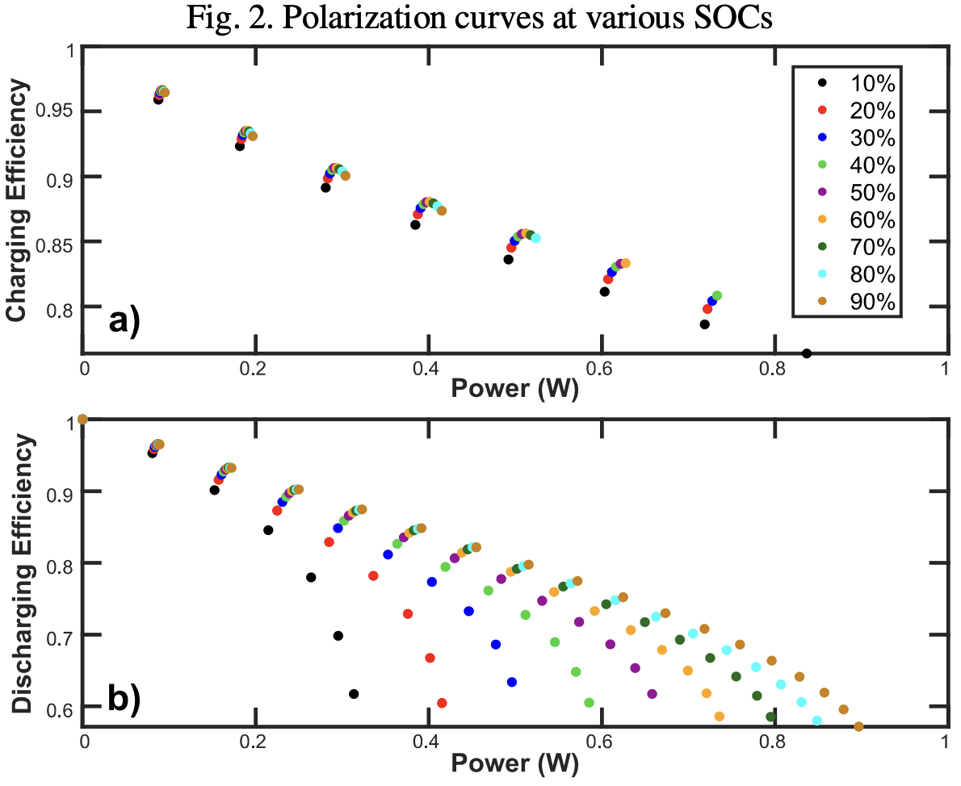
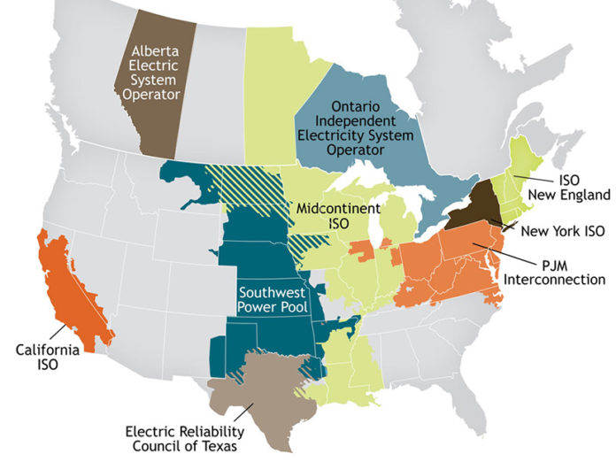
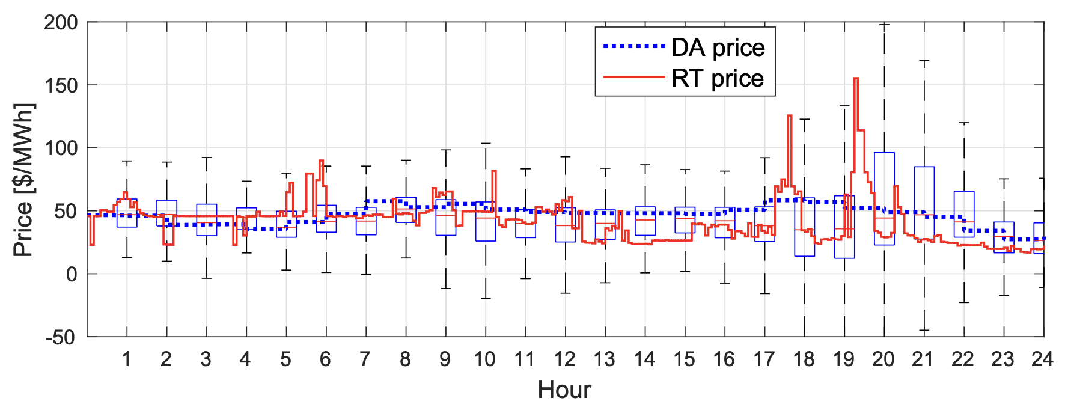
Motivation
Computation complexities in storage control and analytics
Uncertainty Models
Nonlinear Storage Models
Dispatch Models
Xu, Bolun, Magnus Korpås, and Audun Botterud. "Operational Valuation of Energy Storage under Multi-stage Price Uncertainties." In 2020 59th IEEE Conference on Decision and Control (CDC), pp. 55-60. IEEE, 2020.
Chen, Yonghong, and Ross Baldick. "Battery storage formulation and impact on day ahead security constrained unit commitment." IEEE Transactions on Power Systems (2022).
Jafari, Mehdi, Kara Rodby, John Leonard Barton, Fikile Brushett, and Audun Botterud. "Improved energy arbitrage optimization with detailed flow battery characterization." In 2019 IEEE Power & Energy Society General Meeting (PESGM), pp. 1-5. IEEE, 2019.

Slide 5
Outline
Incorporating SoC dependent parameters and opportunity cost
Storage opportunity cost calculation using dynamic programming
CAISO and ISO-NE case studies
Conclusion and future direction

Slide 6
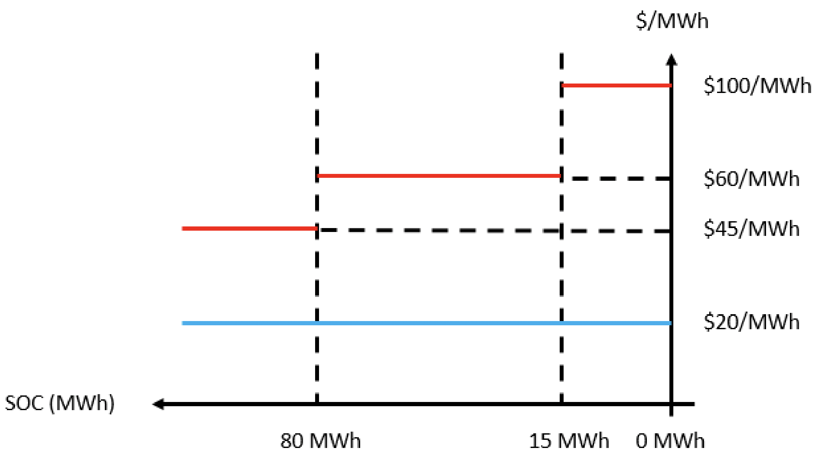
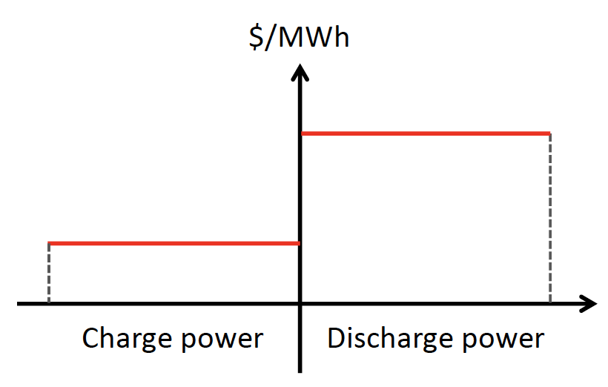
Dispatch and Bidding Analysis
Include Storage into Single-Period Economic Dispatch
Existing Single Segment Bids
Storage submits one bid to charge
and one bid to discharge
SoC-segment Market Model
Charge and discharge bids depend on SoC
(being proposed in CAISO)

Slide 7
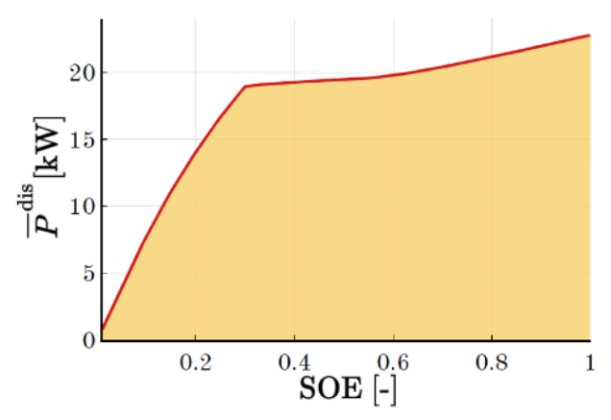
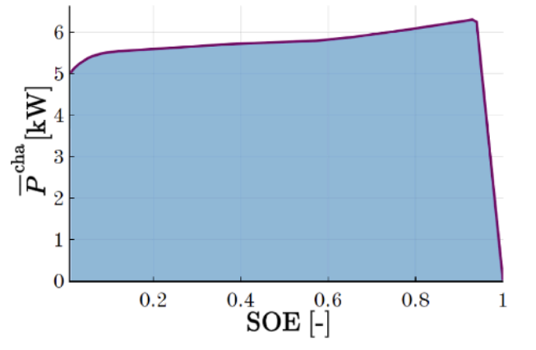
SoC Dependent Parameters
Power rating, efficiency, and discharge cost depends on SoC
Alvaro Gonzalez-Castellanos, David Pozo, and Aldo Bischi. 2020. Detailed Li-ion battery characterization model for economic operation. International Journal of Electrical Power & Energy Systems 116 (2020), 105561. https://doi.org/10.1016/j.ijepes.2019.105561

Slide 8
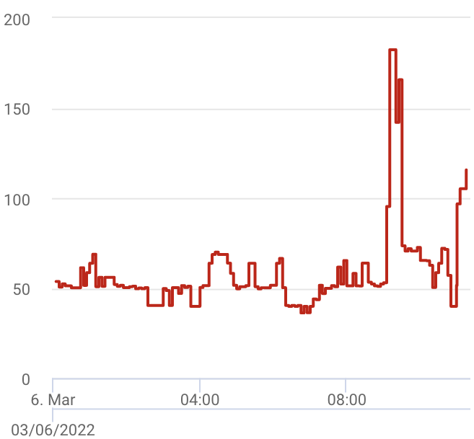
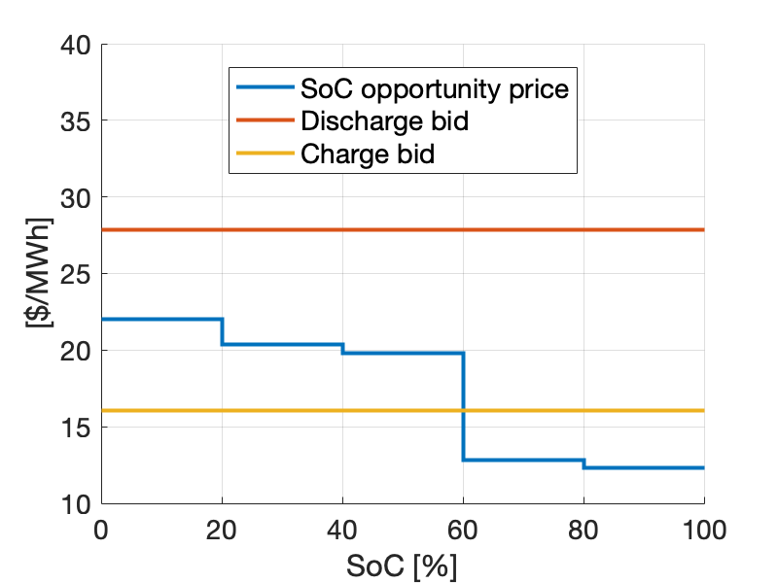
SoC Dependent Parameters
Power rating, efficiency, and discharge cost depends on SoC
Arbitrage
Storage Model
Bidding
Opportunity Value Function (Derivative)

Slide 9
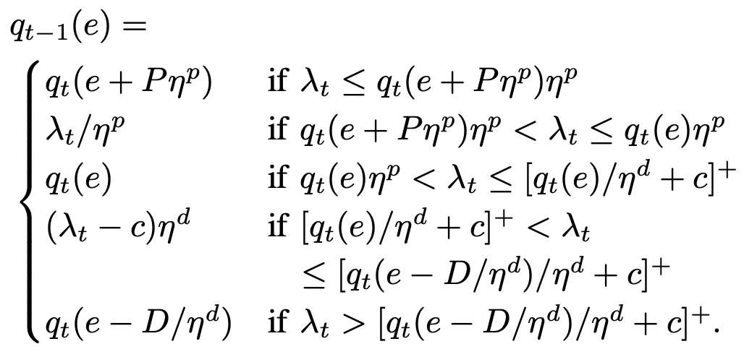
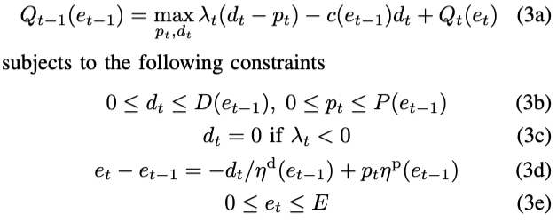
Solution Algorithm
Analytical update of value function derivative $q_{t}\left(e\right)=∂Q_{t}(e)/∂e$
Formulation
Solution Algorithm
Proof using KKT conditions:
Xu, Bolun, Magnus Korpås, and Audun Botterud. "Operational Valuation of Energy Storage under Multi-stage Price Uncertainties.“
In 2020 59th IEEE Conference on Decision and Control (CDC), pp. 55-60. IEEE, 2020.

Slide 10
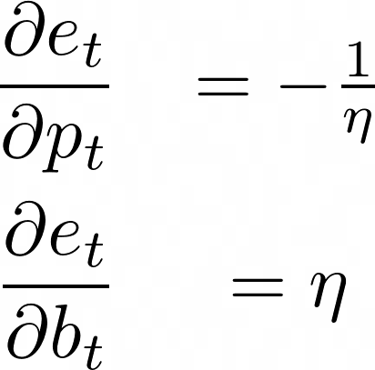
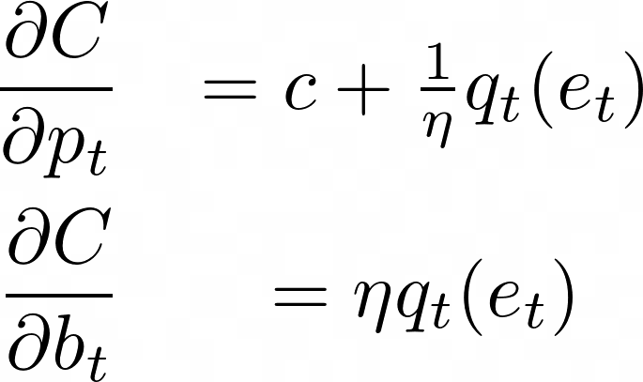
Optimal Bid Generation
Use dynamic programming value function to generate optimal bids
Profit maximization:
Revenue
Cost – To be engineered into bids
SoC constraints:
Storage cost curve:
Discharge curve
Charge curve

Slide 11
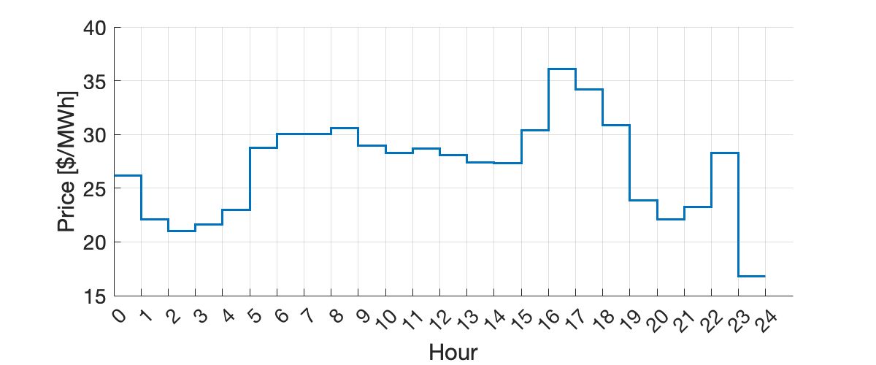
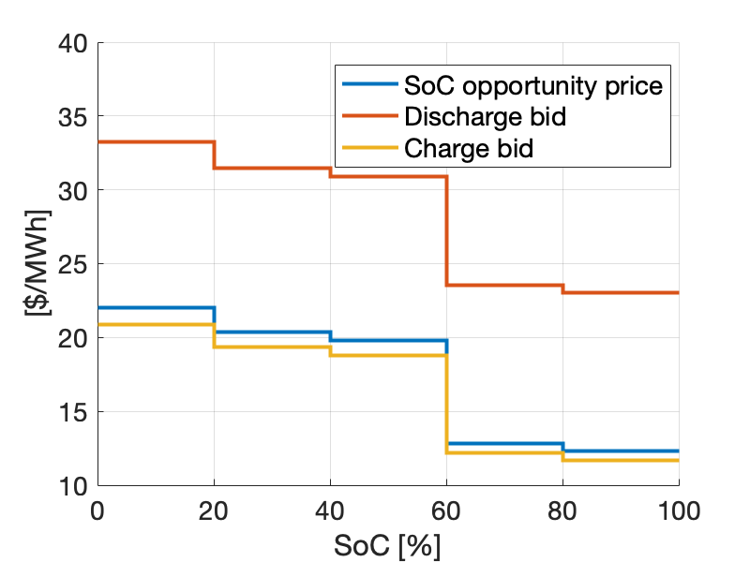
Optimal Bid Generation
Generate bids based on price forecasts and storage parameters
Storage parameters:
4 Hour duration
85% round-trip eff.
10$/MWh discharge cost
+
Solve dynamic programming
(<1ms computation time)
1-seg bid (existing bids)
5-seg bid (SoC bids)

Slide 12
Case Study
Price Taker
Won’t affect market price
Arbitrage profitability
With/without SoC dependent parameters
Price Influencer
Influence market price
System operational cost
Electricity price

Slide 13
Price Taker Case Study
CA Walnut 2016 / Perfect forecast / Single period dispatch
Hour-ahead bidding
Storage submits same bids for one hour, cleared 12 times (5-minute)
Solution time shown for full year simulation
Multi (Benchmark): Multi-period LP no bidding model
RTD-5: 5-segment model
RTD-1: 1-segment model
SoC Independent storage models (constant parameters)
5-segment model improves profits by 10%

Slide 14
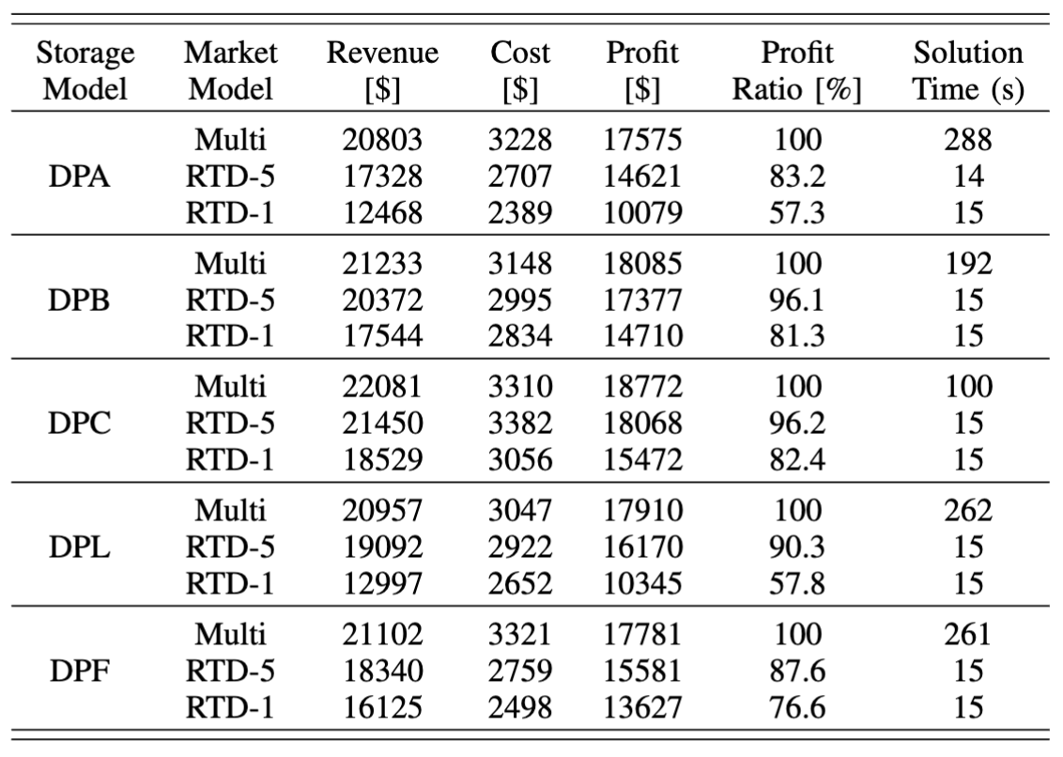
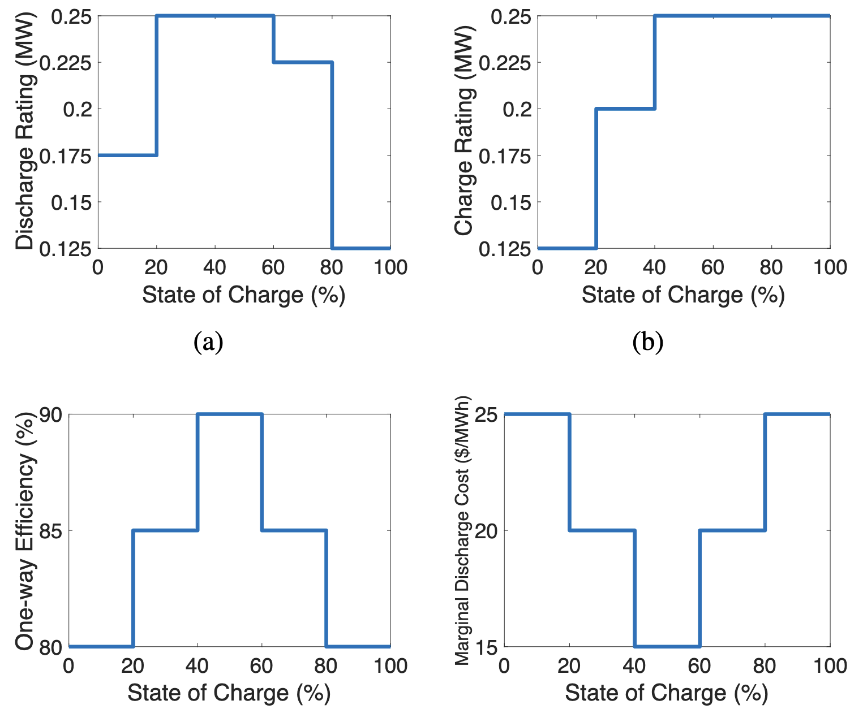
Price Taker Case Study
Market Dispatch Performance for SoC Dependent Storage Model
Discharge rating
Charge rating
Efficiency
Discharge cost

Slide 15
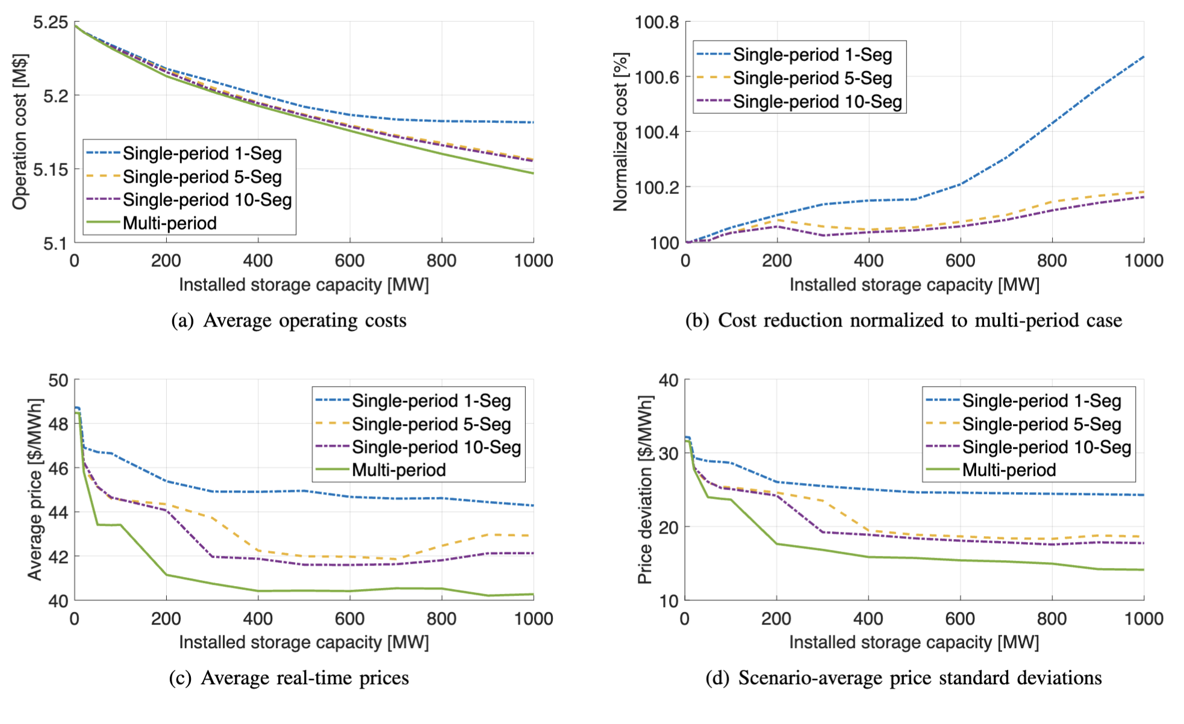
Price Influencer Case Study
ISO-NE test system, Real-time market, 4 hour storage
https://arxiv.org/pdf/2207.07221.pdf

Slide 16
Conclusion and Future Directions
Computational efficient dynamic programming provides a foundation for storage control, bidding, and integration analysis
Improve solution to storage model with state of charge dependent parameters
Incorporate uncertainties in integration analysis
Investigate implications of different market regulations

Slide 17
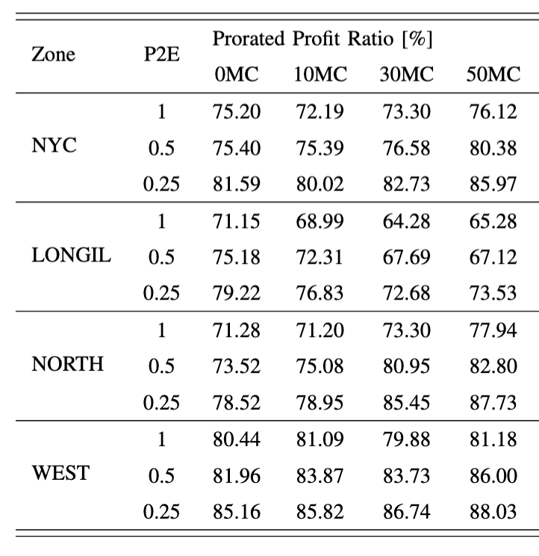
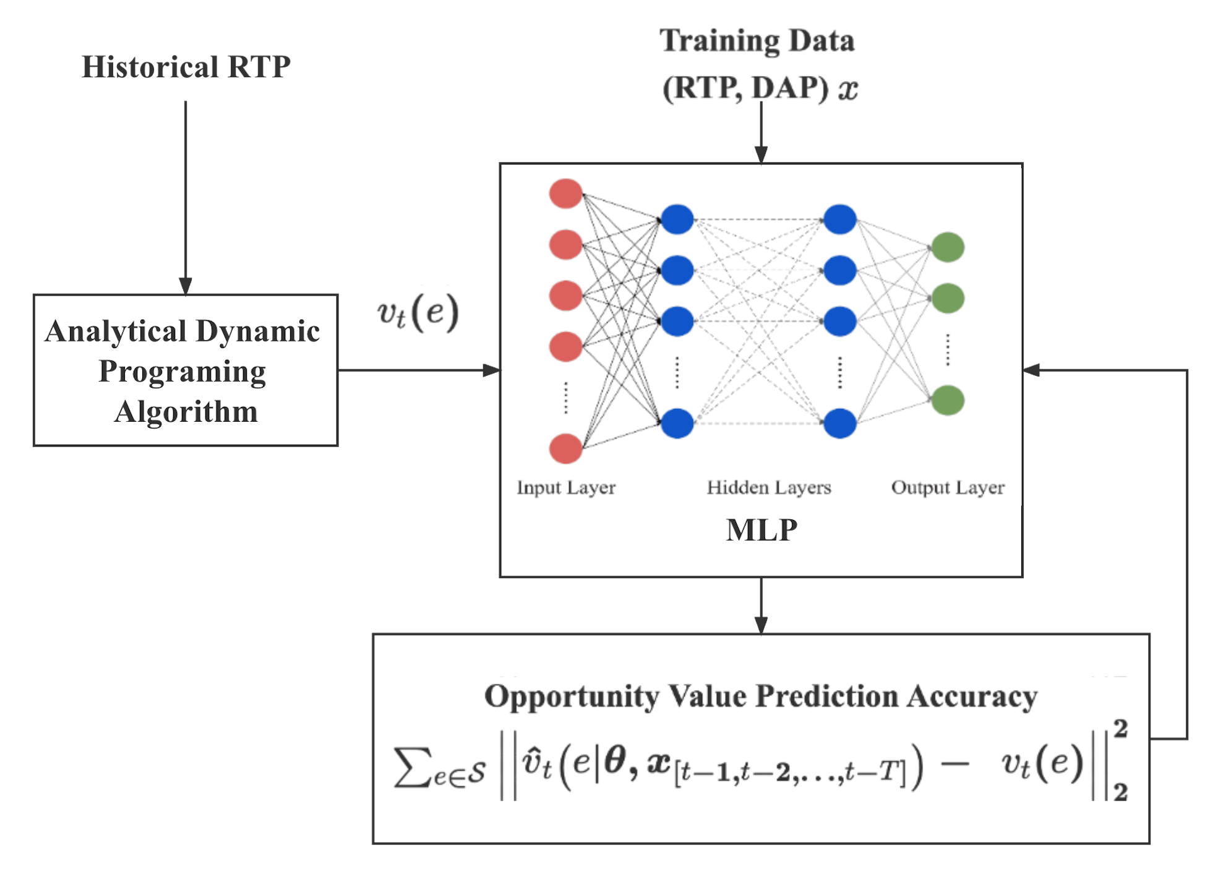
Uncertainty in Price
65% to 90% profit ratio with extreme computational speed
2-year training in 2mins – 210,240 time steps
1-year testing in 10secs – 105,120 time steps

Slide 18
Thank you!
https://bolunxu.github.io/
Joshua Jaworski
Xin Qin
Di Wu
Gabe Murtaugh
Bolun Xu
References:
Xu, Bolun, Magnus Korpås, and Audun Botterud. "Operational Valuation of Energy Storage under Multi-stage Price Uncertainties." In 2020 59th IEEE Conference on Decision and Control (CDC), pp. 55-60. IEEE, 2020.
Zheng, Ningkun, Joshua Jerzy Jaworski, and Bolun Xu. "Arbitraging Variable Efficiency Energy Storage using Analytical Stochastic Dynamic Programming." IEEE Transactions on Power Systems (2022).
Zheng, Ningkun, and Bolun Xu. "Impact of Bidding and Dispatch Models over Energy Storage Utilization in Bulk Power Systems." IREP Bulk Power System Dynamics and Control Conference 2022.
Ningkun Zheng, Xin Qin, Di Wu, Gabe Murtaugh, and Bolun Xu. “Energy Storage State-of-Charge Market Model”, https://arxiv.org/pdf/2207.07221.pdf

