Slide 2
Integrating Physical Model with Machine Learning for Energy Storage Control
Steven Liu, Ningkun Zheng, Bolun Xu
Columbia University, New York, NY,

Slide 3
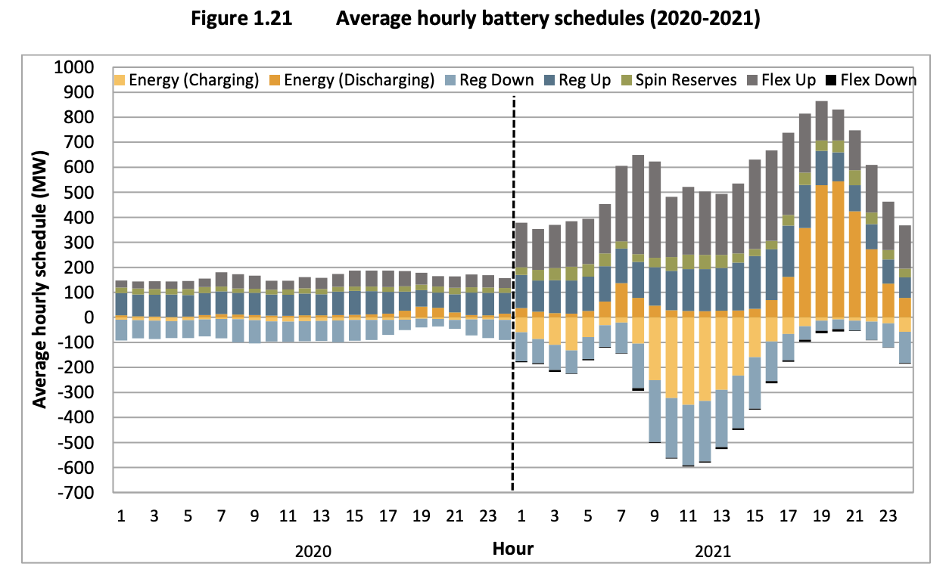
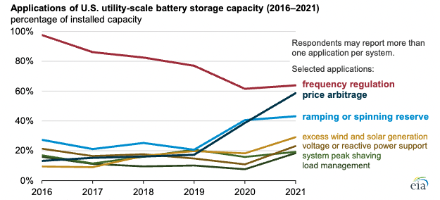
Motivation
Batteries are increasingly used to price arbitrage
Hildebrandt, Eric, et al. "2021 annual report on market issues & performance." California ISO Department of Market Monitoring (2022).
US Energy Information Administration. "Form EIA-860 Annual Electric Generator Report." (2022).
3

Slide 4
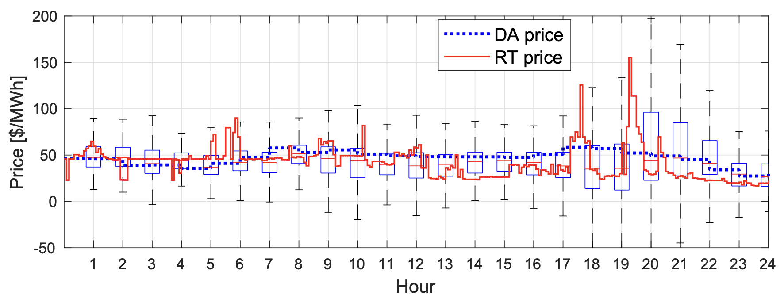
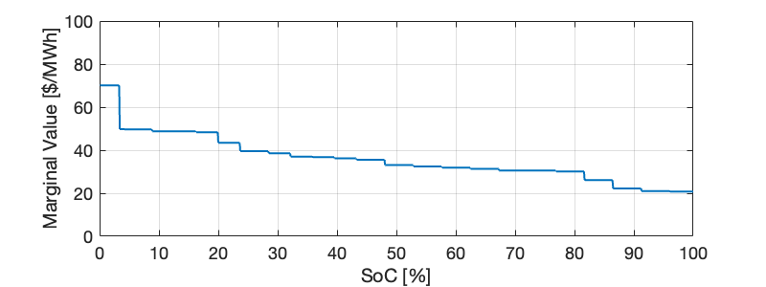
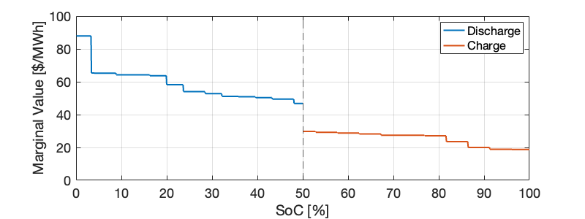
Opportunity value and control
Storage models
Opportunity Value Function (derivative)
Current SoC
RT Price
Xu, Bolun, Magnus Korpås, and Audun Botterud. "Operational Valuation of Energy Storage under Multi-stage Price Uncertainties." In 2020 59th IEEE Conference on Decision and Control (CDC), pp. 55-60. IEEE, 2020.
4

Slide 5
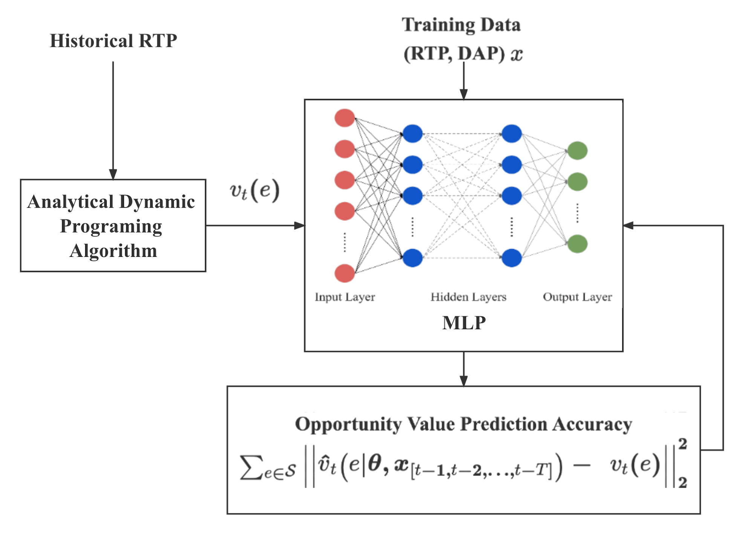
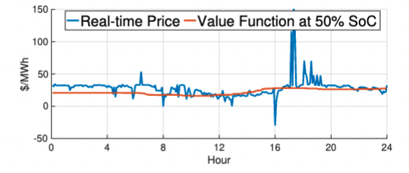
Learning Opportunity Value
Standard 4-layer structure
ReLu as activate function
Ground Truth
Value function is more stable
compared to real-time price
5

Slide 6
New York State Case Study
Train price model using 2017-2018 data and test on 2019
6

Slide 7
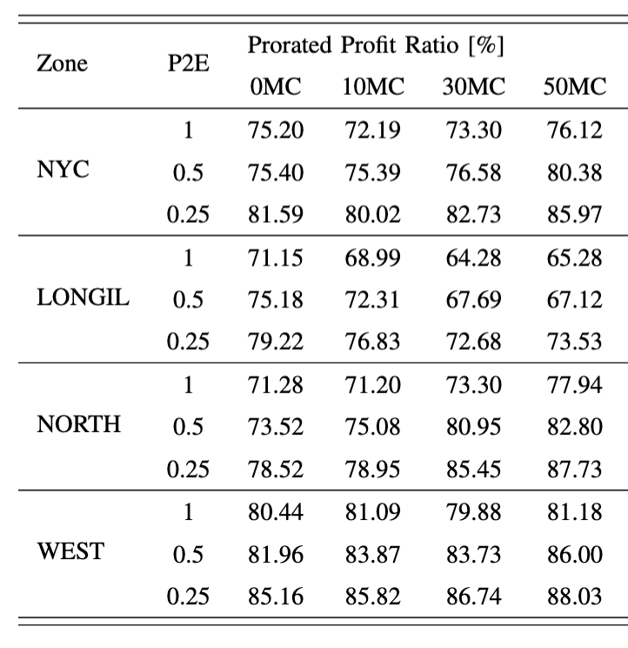
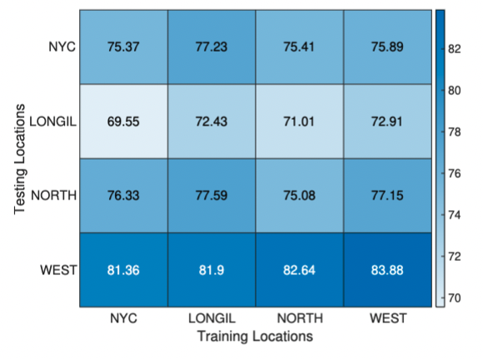
New York State Case Study
65% to 90% profit ratio with extreme computation speed
2-year training in 2mins – 210,240 time steps
1-year testing in 10secs – 105,120 time steps
Superior transferability:
Good profitability with model trained in other locations
P2E – power to energy ratio,
MC – marginal cost
Trained by NYISO 2017-2018, tested on 2019
7

Slide 8
Conclusion and Future Directions
Learning opportunity value function provides computational efficient and profitable energy storage control
Integrate state of charge dependent storage parameters
Advanced learning structures with fine tuned models
Implement in power grid test system studies
8

Slide 9
Thank you!
https://bolunxu.github.io/
References:
Xu, Bolun, Magnus Korpås, and Audun Botterud. "Operational Valuation of Energy Storage under Multi-stage Price Uncertainties." In 2020 59th IEEE Conference on Decision and Control (CDC), pp. 55-60. IEEE, 2020.
Zheng, Ningkun, Joshua Jerzy Jaworski, and Bolun Xu. "Arbitraging Variable Efficiency Energy Storage using Analytical Stochastic Dynamic Programming." IEEE Transactions on Power Systems (2022).
Zheng, Ningkun, and Bolun Xu. "Impact of Bidding and Dispatch Models over Energy Storage Utilization in Bulk Power Systems." IREP Bulk Power System Dynamics and Control Conference 2022.
Ningkun Zheng, Xin Qin, Di Wu, Gabe Murtaugh, and Bolun Xu. “Energy Storage State-of-Charge Market Model”, https://arxiv.org/pdf/2207.07221.pdf
Steven Liu
Bolun Xu
9

